Slide 1
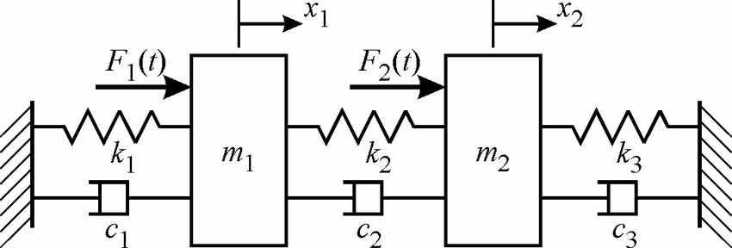
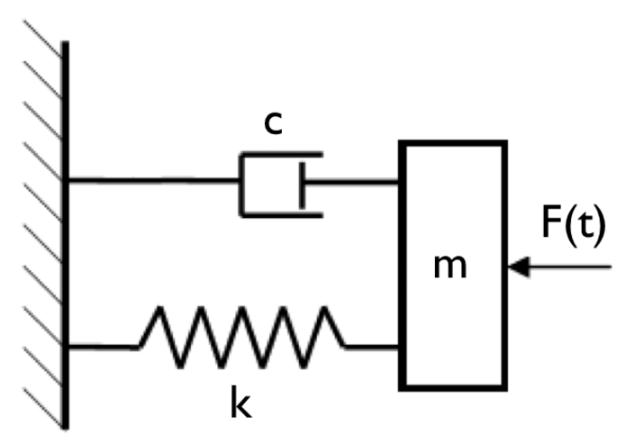
Project Title: Spring Mass System
Simulation of Single and Two Degree of Freedom Spring Mass System

Slide 2
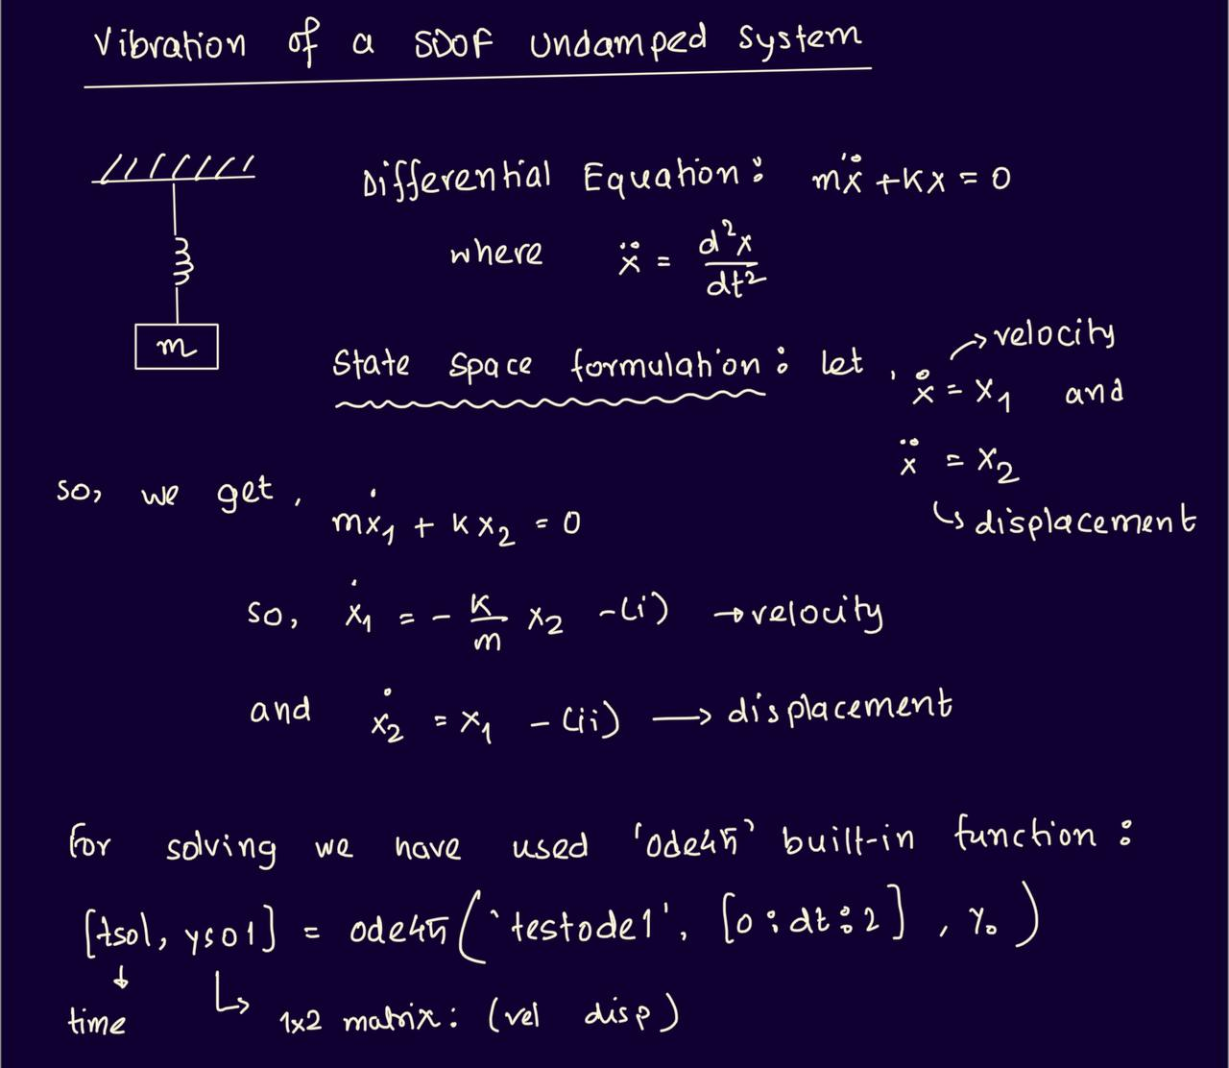
Formulation of a SDOF Spring Mass System

Slide 3
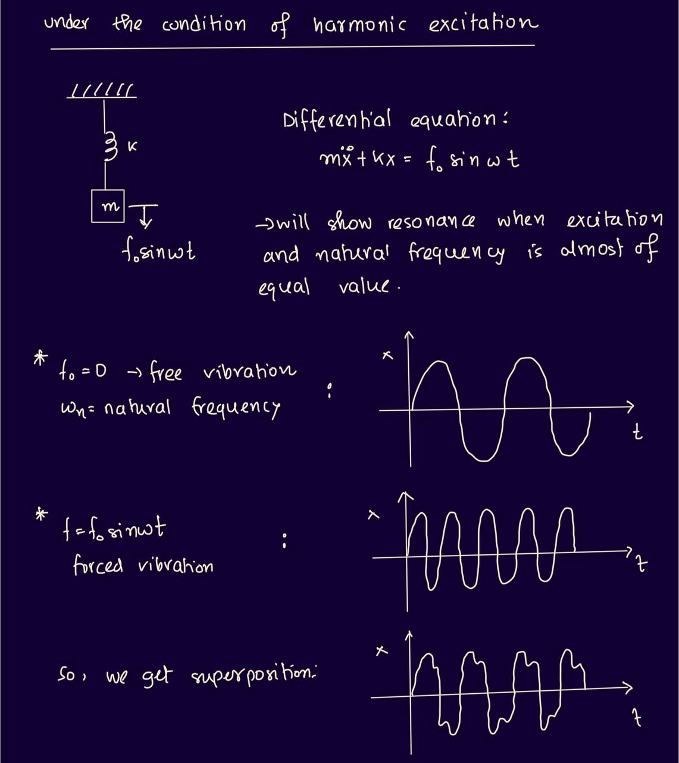
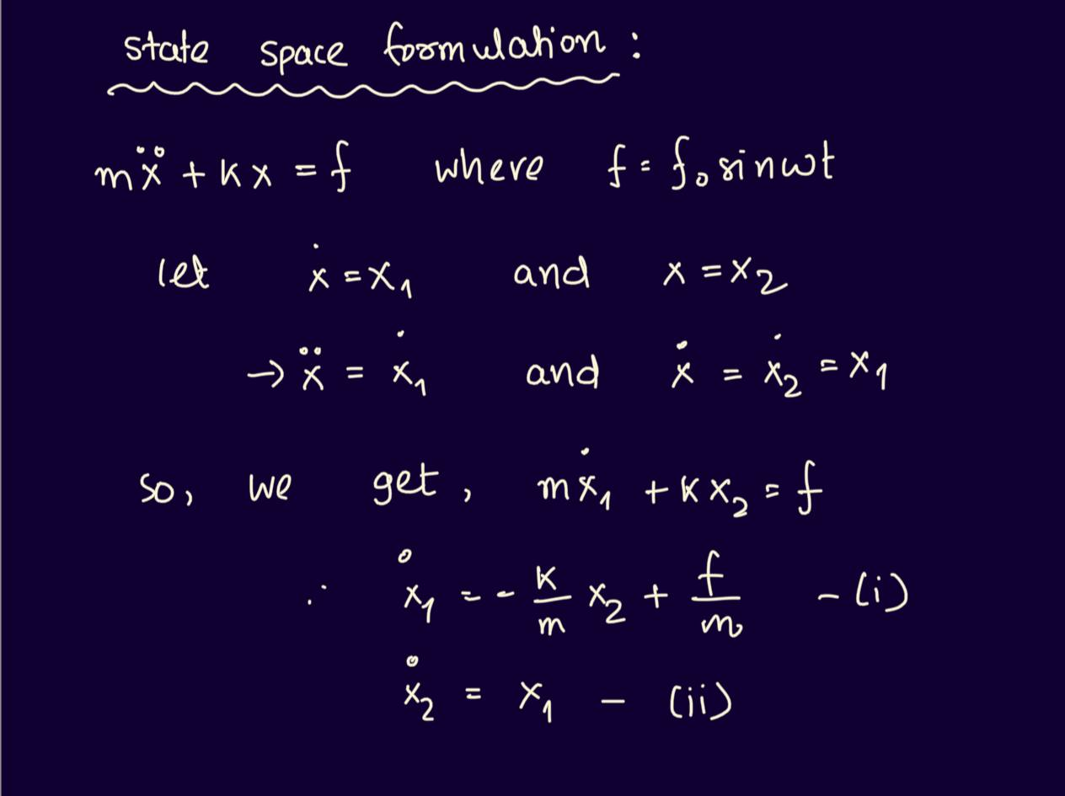
If an External Force is applied:

Slide 4
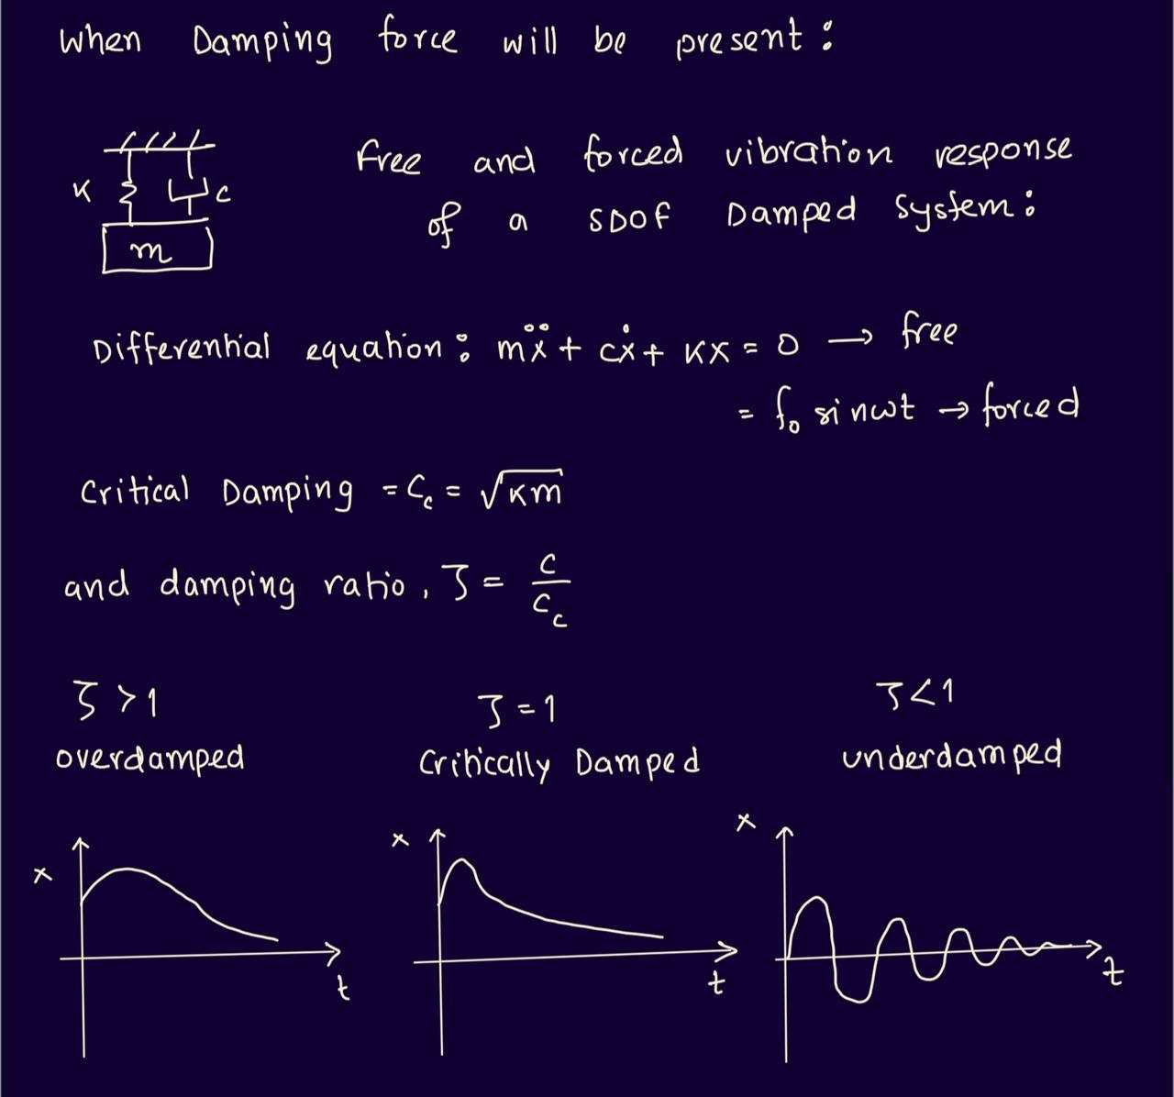
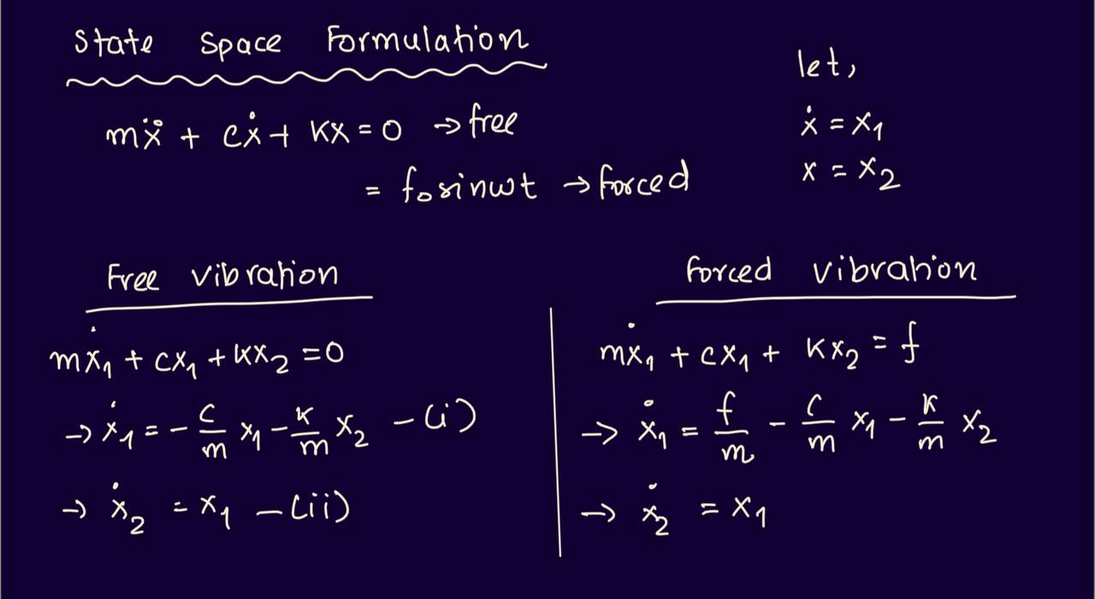
When Damping Force will be present:

Slide 5
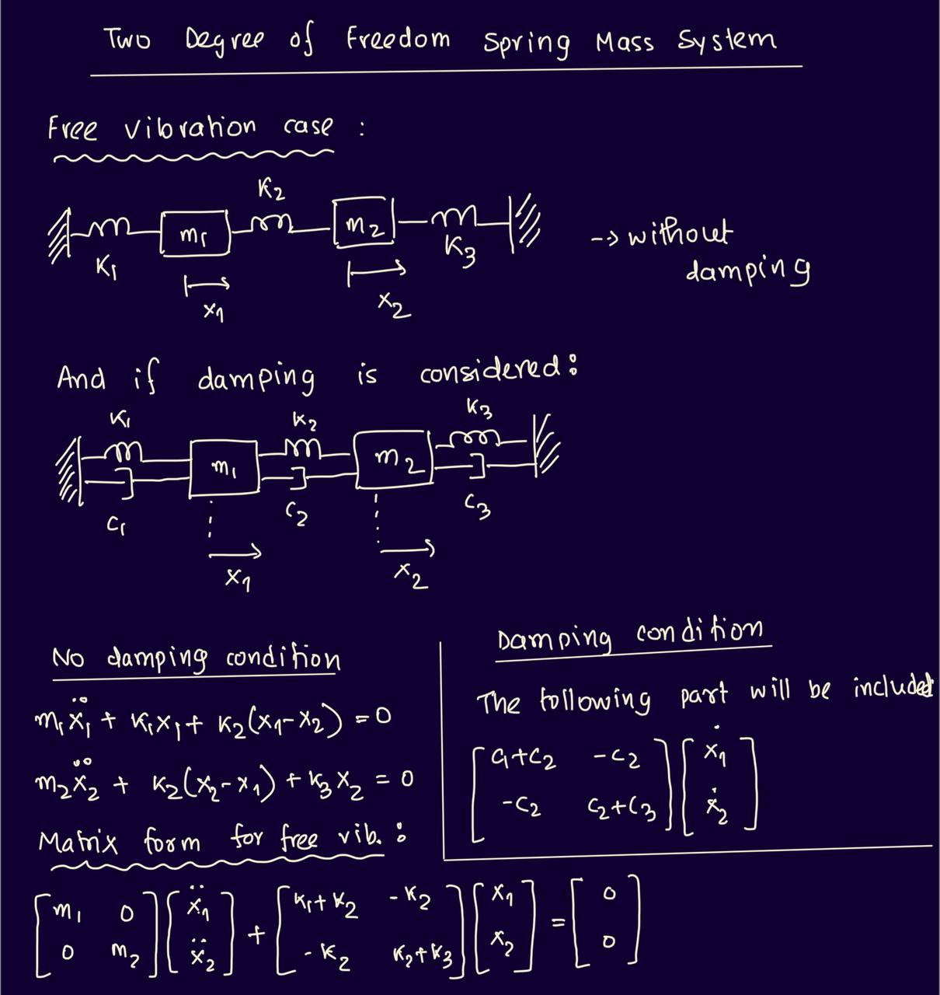
Formulation of Two Degree of Freedom Spring Mass System

Slide 6
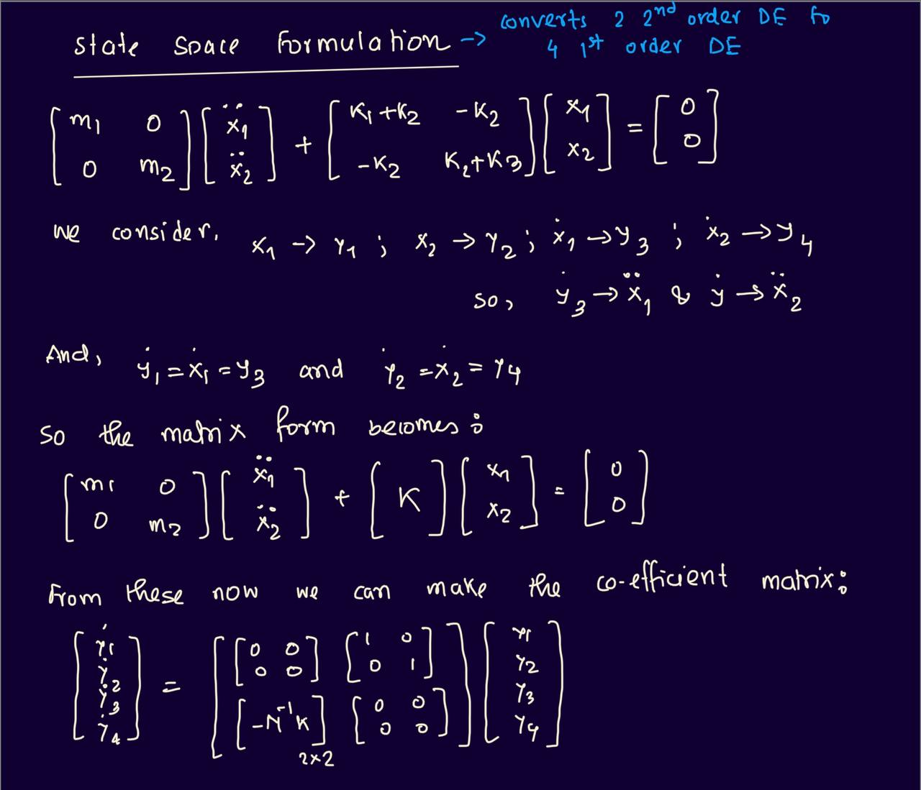
State Space Formulation

Slide 7
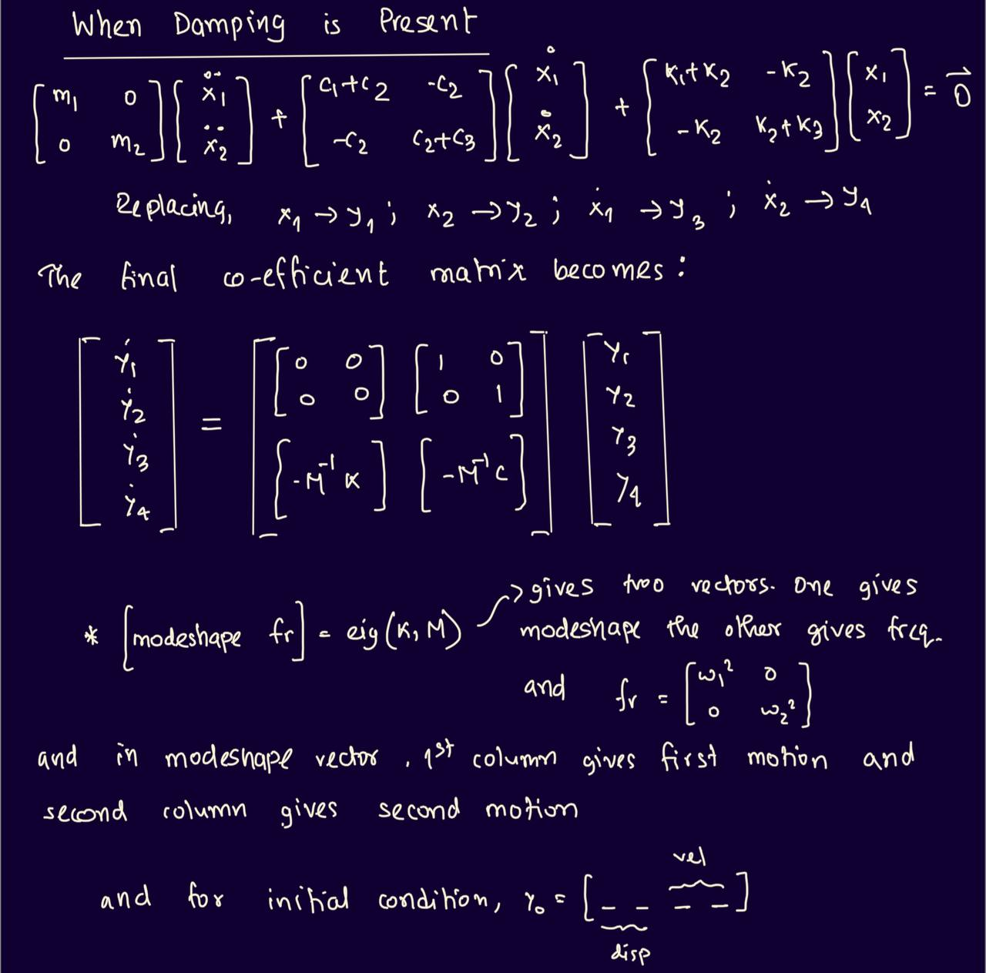
When Damping is present

